Slide 1
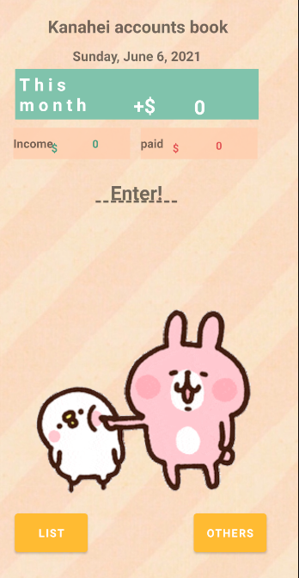
ANDROID FINAL PROJECT
官齊笎108590006
康甜甜 108590058
KANAHEI ACCOUNT BOOK

Slide 2
CONTENTS
Introduction
How to use our app?
List function in our app
Member Contribution

Slide 3
01
INTRODUCTION
KANAHEI ACCOUNT BOOK

Slide 4
KANAHEI ACCOUNT BOOK
INTRODUCTION
the existence of this savings book motivates everyone to be diligent in saving and balancing finances in daily expenses and income. In addition, the Kanahei Account Book has a cute feature that can attract the attention of children to be diligent in their income and even expenses.

Slide 5
02
HOW TO USE OUR APP?
KANAHEI ACCOUNT BOOK

Slide 6
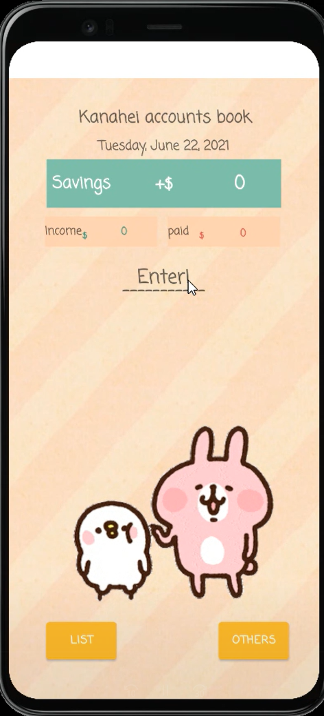
HOW TO USE OUR APP?
1. INTRODUCTION TO THE APP
After opening the KANAHEI ACCOUNT BOOK app, the model on the screen will look like this.
Will automatically adjust the time of the day
This Month of the total money
The money that we have spent on this month
The money that we have save on this month
List of the money that we save or spend
Change the other picture of kanahei

Slide 7
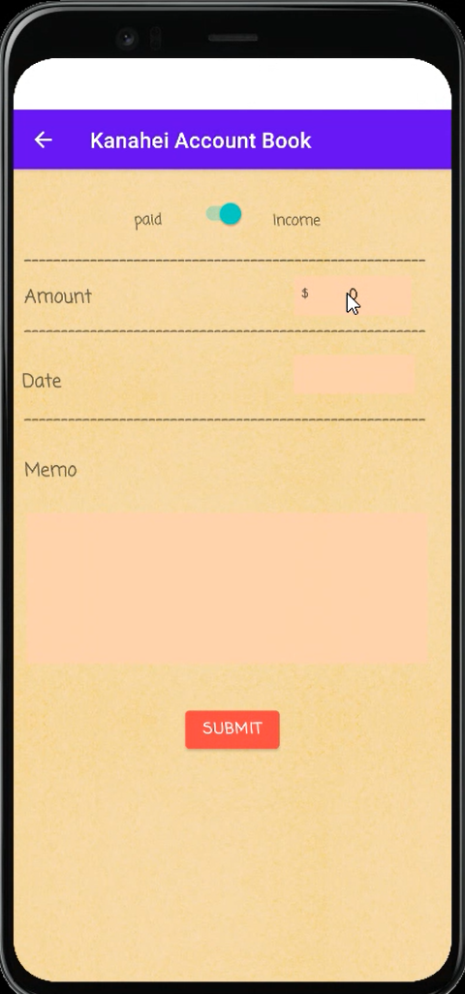
HOW TO USE OUR APP?
2. AFTER WE PRESS ENTER, IT WILL GO TO THIS PAGE
Choose Income or paid, by switching the slider
Put the Amount of the money
Select the date
Put a note to make it more detail
After it done, click SUBMIT

Slide 8
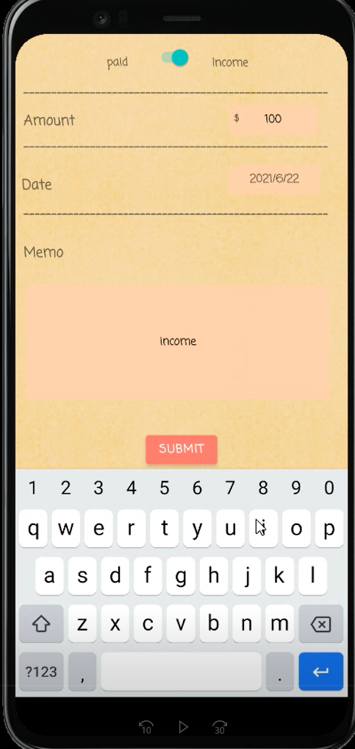
HOW TO USE OUR APP?
3. TRYING THE SECOND STEP , INCOME
I choose income
I put $100 amount of money
Date : 2021/6/22
For detail, I put “income” at the memo
After it done, click SUBMIT

Slide 9
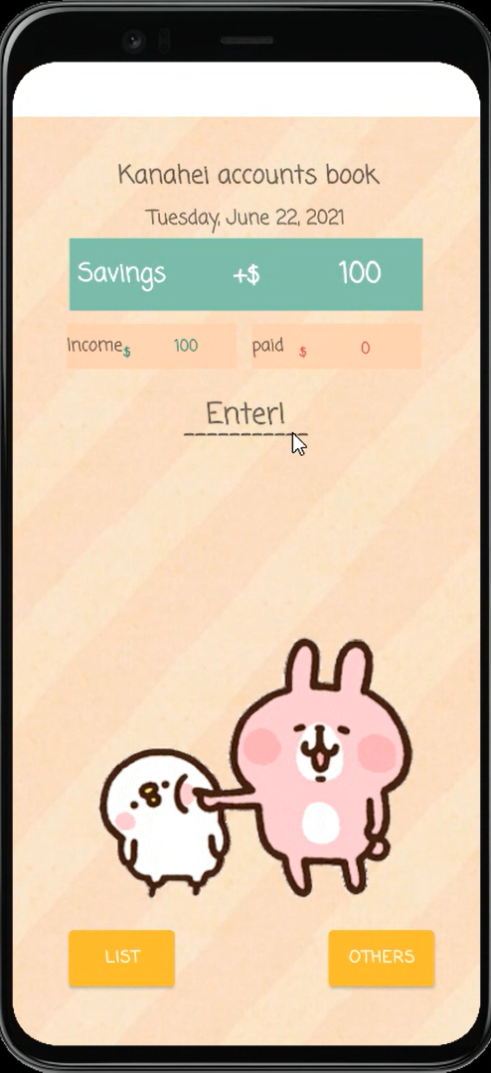
HOW TO USE OUR APP?
4. RESULT OF THIRD STEP
Savings of the total money = $100 (Because just now we put income)
The money that we have spent (paid)= $0
The money that we have save (income) =$100

Slide 10
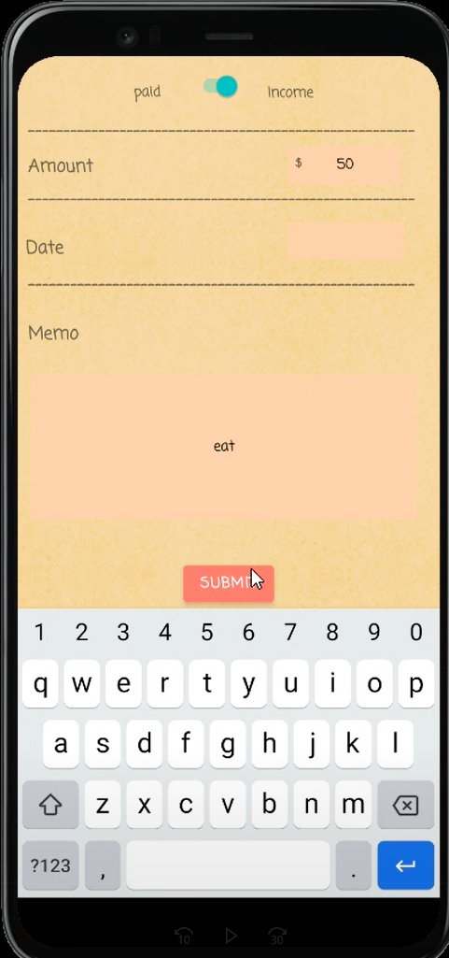
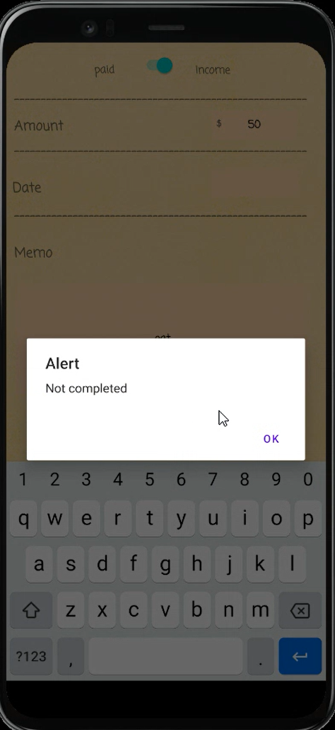
HOW TO USE OUR APP?
TRY NOT TO PUT DATE
I choose income
I put $50 amount of money
Date : -
For detail, I put “eat” at the memo
After it done, click SUBMIT

Slide 11
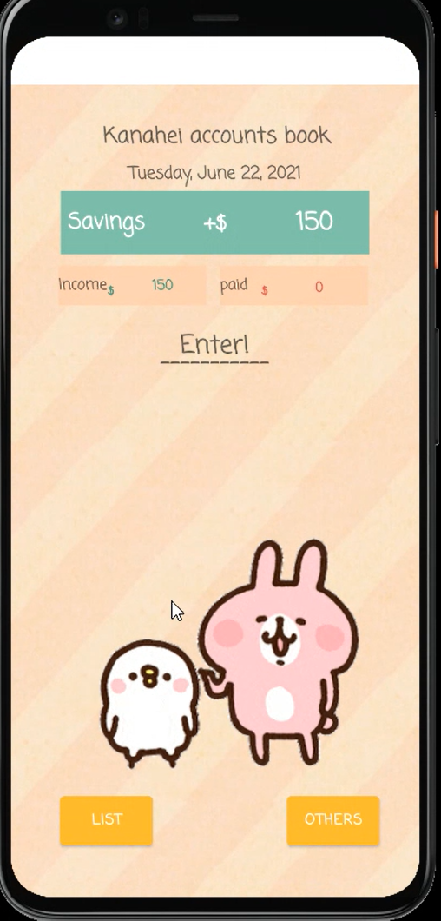
HOW TO USE OUR APP?
RESULT OF FIXING TRY NOT TO PUT DATE
Savings of the total money = $150 (Because just now we put income)
The money that we have spent (paid)= $0
The money that we have save (income) =$150

Slide 12
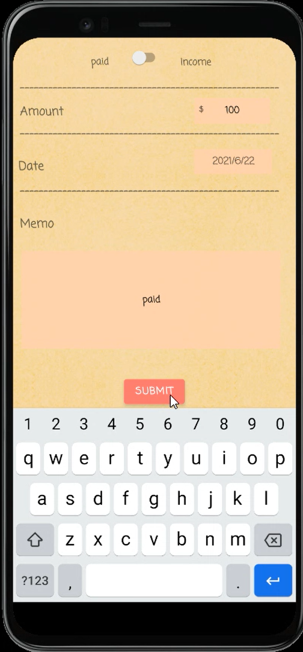
HOW TO USE OUR APP?
5. PAID
I choose paid
I put $100 amount of money
Date : 2021/6/22
For detail, I put “paid” at the memo
After it done, click SUBMIT

Slide 13

HOW TO USE OUR APP?
6. RESULT OF FIFTH STEP
Savings of the total money = $50 ($100+$50-$100=$50)
The money that we have spent (paid)= $100
The money that we have save (income) =$150
Then, click LIST to check the history

Slide 14
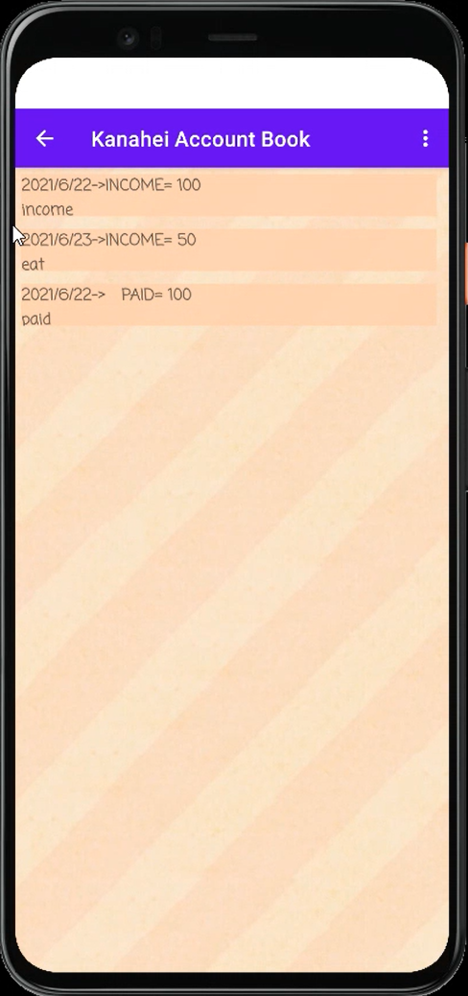
HOW TO USE OUR APP?
7. LIST
On 2021/6/22, I have income $100 memo: income
On 2021/6/23, I have income $50 Memo: eat
On 2021/6/22, I have paid $100 Memo: paid
Click to go back

Slide 15
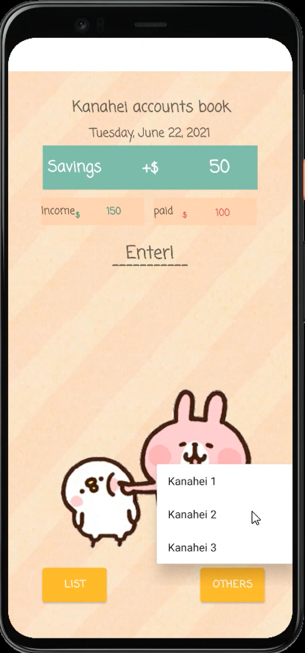
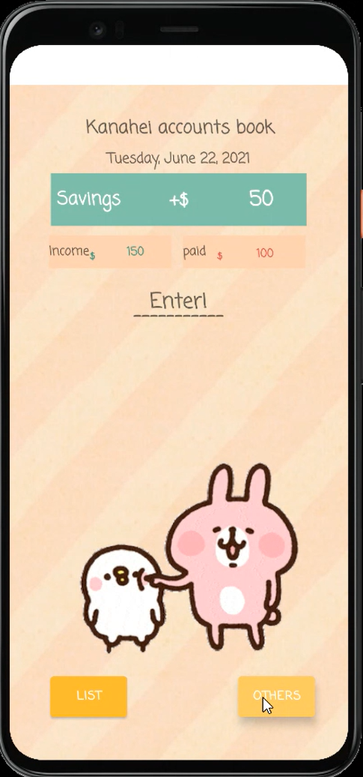
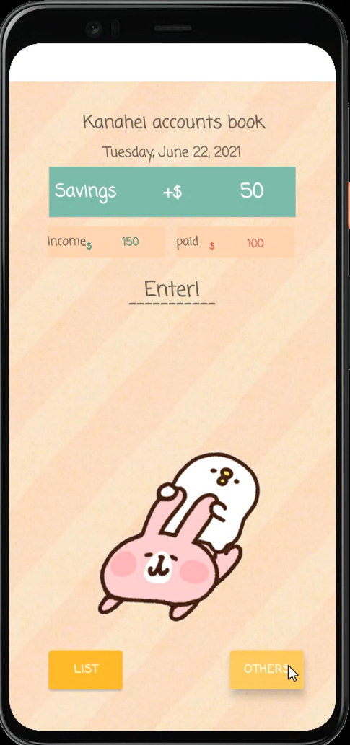
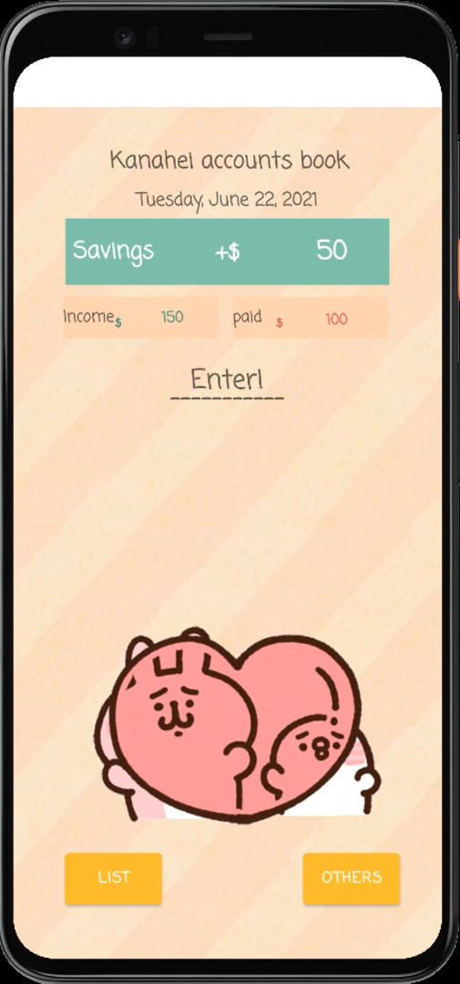
HOW TO USE OUR APP?
8. OTHERS
KANAHEI 1
KANAHEI 2
KANAHEI 3
Kanahei 1
Kanahei 2
Kanahei 3
Click others

Slide 16
03
LIST FUNCTION IN OUR APP
KANAHEI ACCOUNT BOOK

Slide 17
LIST FUNCTION
JAVA
LISTSADAPTER
MAINACTIVITY
SECONDACTIVITY
THIRDACTIVITY
-Button
-Edittext
-Switch
-TextView
-Intent
-LinkedList
-MenuItem
-RecycleView
-LinearrLayoutManager
-Intent
-RecyclerView.Adapter
<ListsAdapter.ListViewHolder>
-LayoutInflater
-PopupMenu
-DateFormat
-Calender
-LinkedList
-RecycleView
-Intent
-MenuItem
-TextView
-SharedPreferences
DATEFRAGMENT
-Calender
-DatePickerDialog
-DialogFragment
1.protected void onCreate(Bundle savedInstanceState) {
2.public void onSecond(View view){
3.public void onThird(View view){
4.protected void onActivityResult (int requestCode, int resultCode, Intent data){
1.protected void onCreate(Bundle savedInstanceState) {
2.public void showDatePickerDialog(View v) {
3.public void processDatePickerResult(int year, int month, int day) {
1.protected void onCreate(Bundle savedInstanceState) {
2. public boolean onCreateOptionsMenu(Menu menu) {
3. public boolean onOptionsItemSelected(MenuItem item) {
ALERTDIALOGACTIVITY
-AlertDialog
-DialogInterface

Slide 18
LIST FUNCTION
RES
LAYOUT
(LIST_ITEM)
DRAWABLE
LAYOUT
(ACTIVITY_MAIN)
LAYOUT
(ACTIVITY_SECOND)
-LinearLayout
-TextView
-kanahei.gif
-kanahei4.gif
-kanahei5.gif
-wallpaper.JPG
-secondwallpaper.png
-TextView
-GifImageview
-button
-ConstraintLayout
-TextView
-EditText
-button
-Switch
-ConstraintLayout
MENU
(MENU_THIRD)
FONT
LAYOUT
(ACTIVITY_THIRD)
LAYOUT
(CONTENT_THIRD)
item
CoordinatorLayout
-RecycleView
-ConstraintLayout
MENU
(POPUP_MENU)
Coming_soon.xml
item

Slide 19
Member Contribution
官齊笎 108590006
康甜甜108590058
50%
50%

Slide 20
DEEMO

Slide 21
THANKS!
Do you have any questions?
getperfectscore @yahoo.com
+0979000000
getperfectscore.com
KANAHEI ACCOUNT BOOK

